Slide 1



AI-Powered Harassment Detection: Creating Safer Online & Workplace Environments

Slide 2

Problem Statement :
AI-Powered Harassment Detector for Workplaces & Social Media
Abstract:
Our AI-powered Harassment Detector is a Chrome extension leveraging Machine Learning (ML) and Natural Language Processing (NLP) to detect and prevent online harassment in real-time. It monitors platforms like Google Meet, Gmail, and social media, analyzing text to identify toxic content and send instant alerts via Slack Webhooks. Trained on diverse datasets, it ensures high accuracy in detecting harmful language, promoting a safer digital environment.

Slide 3


Objectives
✅ Detect harassment in real-time on various websites.
✅ Integrate AI (possibly NLP models) to classify messages as harassment or not.
✅ Make a Chrome Extension that runs automatically on specified sites.
✅ Provide alerts or reports when harassment is detected.
✅ Ensure privacy & efficiency—process data without causing lag.

Slide 4


Key Technology: Natural Language Processing (NLP)
Sentiment Analysis
Identifies emotional tone and negativity in text with 88% accuracy.
Contextual Analysis
Understands the meaning of words in relation to surrounding text with 92% precision.

Slide 5



Solution Overview
Key Features
Real-Time Monitoring – Scans text interactions across supported sites.
AI-Powered Detection – Uses NLP models to classify and flag harassment.
Instant Alerts – Notifies users when harmful language is detected.
User Reporting – Allows flagging, muting, or reporting harassment.
Privacy-Focused – Processes data locally, ensuring user privacy.
Why This Solution?
Proactive & Multi-Platform – Prevents harassment before escalation.
Lightweight & Efficient – Works seamlessly without performance issues.
Scalable – Easily adaptable for new platforms and languages.

Slide 6

Methodology & Implementation
2.Speech-to-Text Integration
Utilized Google Speech-to-Text API to transcribe spoken content.
Analyzed transcriptions for harassment detection in voice-based interactions.
1.Model Training & Fine-Tuning
Trained a custom NLP model on labeled harassment datasets.
Fine-tuned using Perspective API to enhance toxicity detection accuracy.
3.Real-Time Detection & Response
Integrated AI models into a Chrome extension for real-time monitoring.
Provided instant alerts, enabling users to flag, mute, or report harassment.

Slide 7

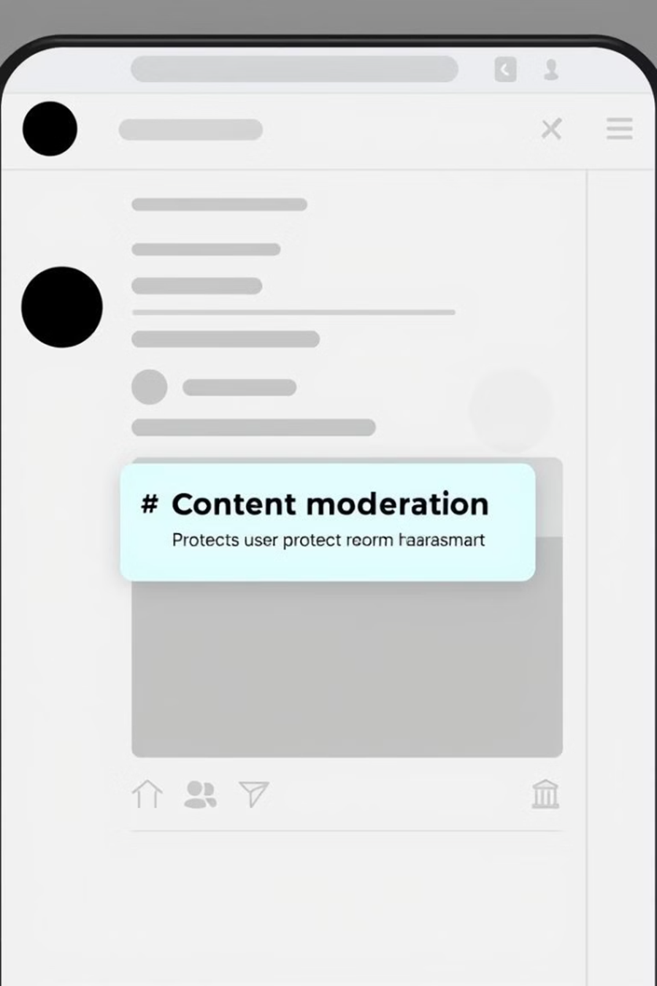



Applications: Social Media Platforms
Detects and removes hateful or abusive content.
2
Identifies and suspends accounts engaging in harassment.
3
Protects vulnerable users from targeted attacks.
4
Enhances platform safety and user experience.

Slide 8

Libraries Used :
pandas – For data manipulation and analysis
numpy – For numerical computations
sklearn (scikit-learn) – For machine learning utilities
pickle – For saving and loading models
Data Processing Techniques:
Tokenizer – Converts text into sequences of integers
Pad Sequences – Ensures sequences have a uniform lengt
Model Architecture:
Embedding Layer – Converts words into dense vector representations)
Flatten Layer – Flattens the embedding output into a 1D vector
Dense Layer – Final classification layer with 3 neurons (low, mid, high categories

Slide 9

Future Enhancements :
Cross-Platform Compatibility
Extend support beyond Chrome to mobile apps and other browsers for wider adoption.
Advanced Context Analysis
Improve AI to detect sarcasm, coded language, and evolving harassment patterns.
Voice & Video Moderation
Extend detection to real-time voice and video interactions using AI models.
User Customization & Adaptive Learning
Allow users to customize sensitivity levels and improve detection through personalization

